Slide 1

Logistic Regression
Let’s learn something!

Slide 2
Python and Spark
Not all labels are continuous, sometimes you need to predict categories, this is known as classification.
Logistic Regression is one of the basic ways to perform classification (don’t be confused by the word “regression”)

Slide 3
Reading Assignment
Sections 4-4.3 of
Introduction to Statistical Learning
By Gareth James, et al.

Slide 4
Python and Spark
If you want to fully understand some of the concepts behind the evaluation methods and metrics behind classification, the reading is highly recommended!

Slide 5
Background
We want to learn about Logistic Regression as a method for Classification.
Some examples of classification problems:
Spam versus “Ham” emails
Loan Default (yes/no)
Disease Diagnosis
Above were all examples of Binary Classification
Math &
Statistics
Machine Learning
DS
Software
Research
Domain
Knowledge

Slide 6
Background
So far we’ve only seen regression problems where we try to predict a continuous value.
Although the name may be confusing at first, logistic regression allows us to solve classification problems, where we are trying to predict discrete categories.
Math &
Statistics
Machine Learning
DS
Software
Research
Domain
Knowledge

Slide 7
Background
The convention for binary classification is to have two classes 0 and 1.
Let’s walk through the basic idea for logistic regression.
We’ll also explain why it has the term regression in it, even though it’s used for classification!
Math &
Statistics
Machine Learning
DS
Software
Research
Domain
Knowledge

Slide 8
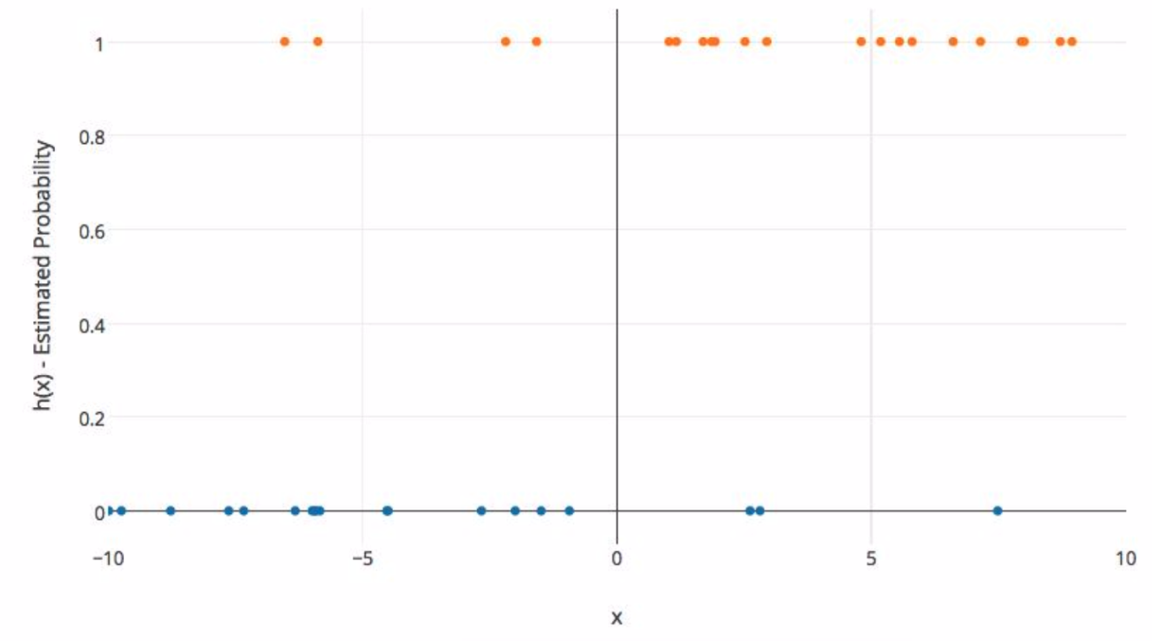
Background
Imagine we plotted out some categorical data against one feature.
Math &
Statistics
Machine Learning
DS
Software
Research
Domain
Knowledge

Slide 9
Background
The X axis represents a feature value and the Y axis represents the probability of belonging to class 1.
Math &
Statistics
Machine Learning
DS
Software
Research
Domain
Knowledge

Slide 10
Background
We can’t use a normal linear regression model on binary groups. It won’t lead to a good fit:
Math &
Statistics
Machine Learning
DS
Software
Research
Domain
Knowledge

Slide 11
Background
We need a function that will fit binary categorical data!
Math &
Statistics
Machine Learning
DS
Software
Research
Domain
Knowledge

Slide 12
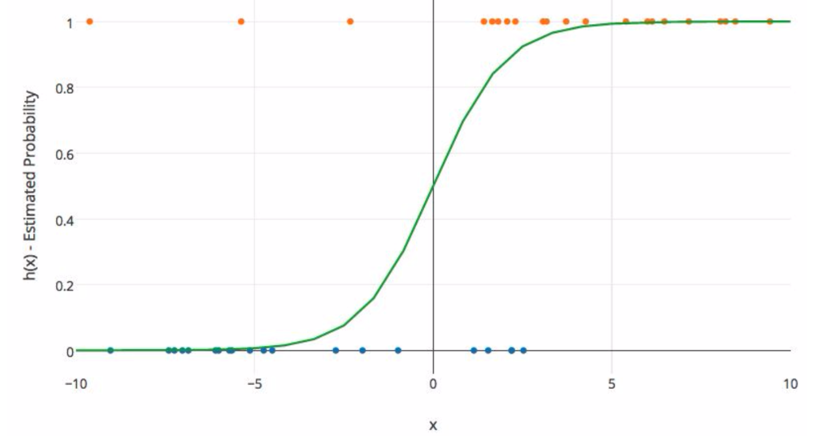
Background
It would be great if we could find a function with this sort of behavior:
Math &
Statistics
Machine Learning
DS
Software
Research
Domain
Knowledge

Slide 13
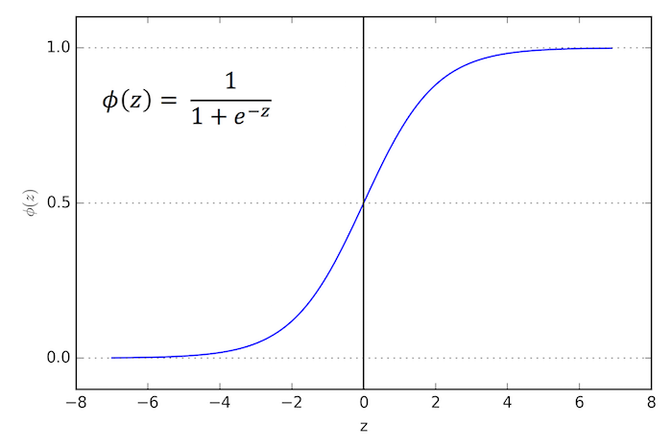
Sigmoid Function
The Sigmoid (aka Logistic) Function takes in any value and outputs it to be between 0 and 1.
Math &
Statistics
Machine Learning
DS
Software
Research
Domain
Knowledge

Slide 14
Sigmoid Function
This means we can take our Linear Regression Solution and place it into the Sigmoid Function.
Math &
Statistics
Machine Learning
DS
Software
Research
Domain
Knowledge

Slide 15
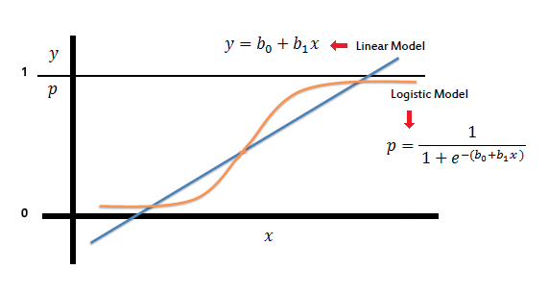
Sigmoid Function
This means we can take our Linear Regression Solution and place it into the Sigmoid Function.
Math &
Statistics
Machine Learning
DS
Software
Research
Domain
Knowledge

Slide 16
Sigmoid Function
This results in a probability from 0 to 1 of belonging in the 1 class.
Math &
Statistics
Machine Learning
DS
Software
Research
Domain
Knowledge

Slide 17
Sigmoid Function
We can set a cutoff point at 0.5, anything below it results in class 0, anything above is class 1.
Math &
Statistics
Machine Learning
DS
Software
Research
Domain
Knowledge

Slide 18
Review
We use the logistic function to output a value ranging from 0 to 1. Based off of this probability we assign a class.
Math &
Statistics
Machine Learning
DS
Software
Research
Domain
Knowledge

Slide 19
Model Evaluation
After you train a logistic regression model on some training data, you will evaluate your model’s performance on some test data.
You can use a confusion matrix to evaluate classification models.
Math &
Statistics
Machine Learning
DS
Software
Research
Domain
Knowledge

Slide 20
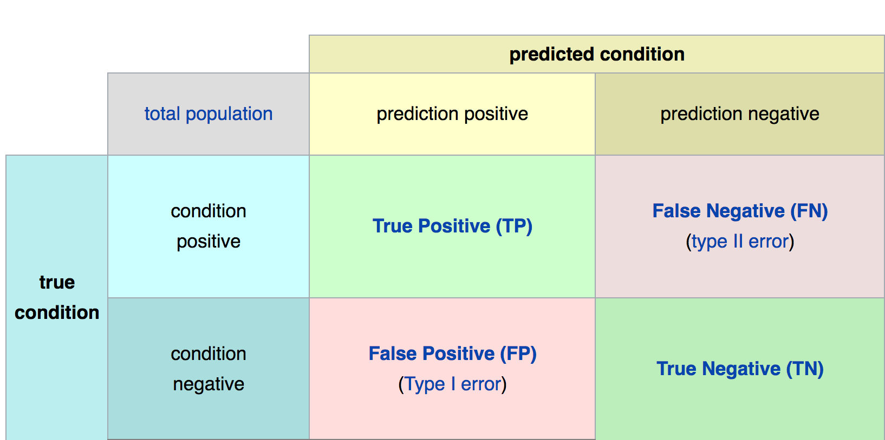
Confusion Matrix
Math &
Statistics
Machine Learning
DS
Software
Research
Domain
Knowledge

Slide 21
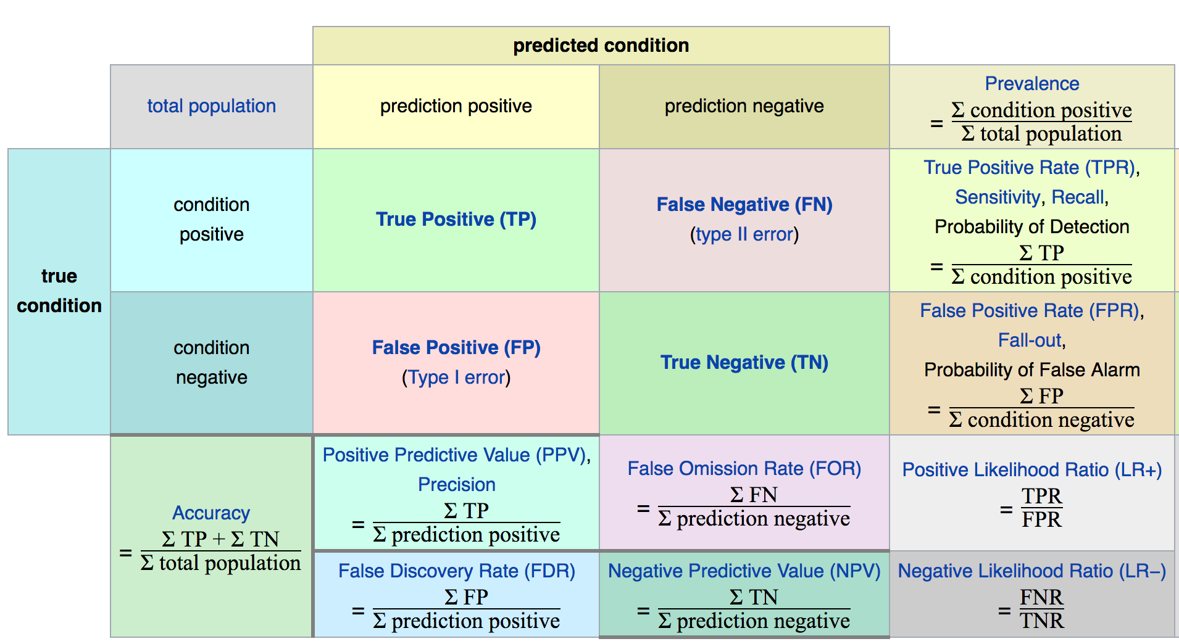
Confusion Matrix
Math &
Statistics
Machine Learning
DS
Software
Research
Domain
Knowledge

Slide 22
Model Evaluation
The main point to remember with the confusion matrix and the various calculated metrics is that they are all fundamentally ways of comparing the predicted values versus the true values.
What constitutes “good” metrics, will really depend on the specific situation!
Math &
Statistics
Machine Learning
DS
Software
Research
Domain
Knowledge

Slide 23
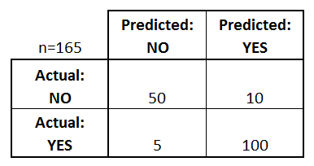
Model Evaluation
We can use a confusion matrix to evaluate our model.
For example, imagine testing for disease.
Math &
Statistics
Machine Learning
Example: Test for presence of disease
NO = negative test = False = 0
YES = positive test = True = 1
DS
Software
Research
Domain
Knowledge

Slide 24
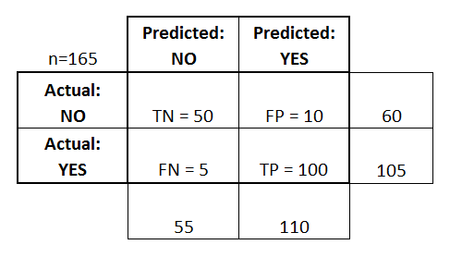
Confusion Matrix
Basic Terminology:
True Positives (TP)
True Negatives (TN)
False Positives (FP)
False Negatives (FN)
Math &
Statistics
Machine Learning
DS
Software
Research
Domain
Knowledge

Slide 25
Confusion Matrix
Math &
Statistics
Machine Learning
Accuracy:
Overall, how often is it correct?
(TP + TN) / total = 150/165 = 0.91
DS
Software
Research
Domain
Knowledge

Slide 26
Confusion Matrix
Misclassification Rate (Error Rate):
Overall, how often is it wrong?
(FP + FN) / total = 15/165 = 0.09
Math &
Statistics
Machine Learning
DS
Software
Research
Domain
Knowledge

Slide 27
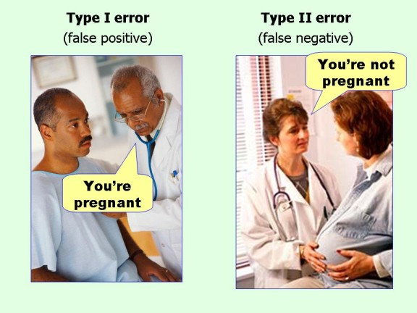
Confusion Matrix
Math &
Statistics
Machine Learning
DS
Software
Research
Domain
Knowledge

Slide 28
Model Evaluation
Still confused on the confusion matrix?
No problem! Check out the Wikipedia page for it, it has a really good diagram with all the formulas for all the metrics.
Throughout the course, we’ll usually just print out metrics (e.g. accuracy).
Math &
Statistics
Machine Learning
DS
Software
Research
Domain
Knowledge

Slide 29
Model Evaluation
Binary classification has some of its own special classification metrics.
These include visualizations of metrics from the confusion matrix.
The Receiver Operator Curve (ROC) curve was developed during World War II to help analyze radar data.
Math &
Statistics
Machine Learning
DS
Software
Research
Domain
Knowledge

Slide 30
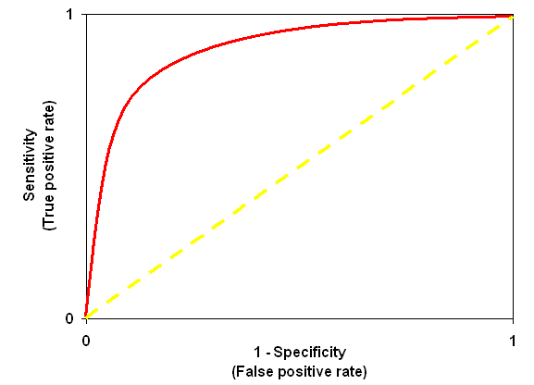
Model Evaluation
The ROC curve:
Math &
Statistics
Machine Learning
DS
Software
Research
Domain
Knowledge

Slide 31
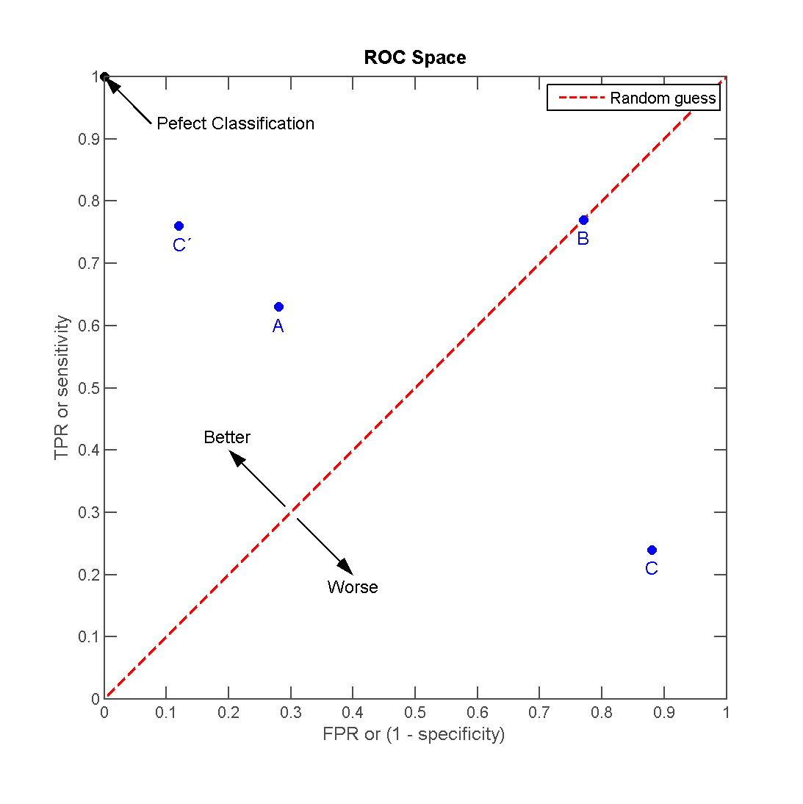
Model Evaluation
Math &
Statistics
Machine Learning
DS
Software
Research
Domain
Knowledge

Slide 32
Model Evaluation
A full discussion of the ROC curve is beyond the scope of this course, but the reading assignment goes into much more detail.
For now, you just need to know that the area under the curve is a metric for how well a model fit the data.
Math &
Statistics
Machine Learning
DS
Software
Research
Domain
Knowledge

Slide 33
Model Evaluation
Let’s continue on exploring these concepts with a walk through of the documentation example
We’ll also add some more stuff on evaluation to the example!
Math &
Statistics
Machine Learning
DS
Software
Research
Domain
Knowledge

Slide 34
Logistic Regression
Documentation Example

Slide 35
Python and Spark
Let’s quickly walk through the documentation Logistic Regression example.
After viewing this, you should begin to pick up on Spark’s pattern for machine learning syntax.

Slide 36
Python and Spark
We will also introduce the concept of “Evaluators”.
Evaluators behave similar to Machine Learning Algorithm objects, but are designed to take in evaluation DataFrames ~ model.evaluate(test_data)

Slide 37
Python and Spark
Evaluators are technically still “experimental” according to the documentation, so use caution when using them for production code.
But they have been a part of Spark since version 1.4 , so they have some stability.

Slide 38
Python and Spark
The files for this lecture are
Logistic_Regression_Example.ipynb
sample_libsvm_data.txt
Look under the Logistic Regression folder under the Machine Learning folder.
All links we show can be found in the notebook.

Slide 39
Python and Spark
Let’s get started in a new notebook!

Slide 40
Logistic Regression
Code Along

Slide 41
Python and Spark
Let’s work through a “classic” classification example!
The titanic dataset is a common exercise for classification in machine learning, there are lots of examples of it online for other machine learning libraries!

Slide 42
Python and Spark
We’ll use it to attempt to predict what passengers survived the titanic crash based solely on passenger’s features (age, cabin, children, etc…)
We will also explore a few more things!

Slide 43
Python and Spark
We’ll see some better ways to deal with categorical data through a two-step process.
We will also show how to use pipelines to set stages and build models that can be easily used again!

Slide 44
Python and Spark
Our data will also have a lot of missing information, so we will need to deal with that as well.
Let’s get started!

Slide 45
Logistic Regression
Consulting Project

Slide 46
Python and Spark
You did such a great job on the previous consulting project that word is starting to spread about your abilities!
You’ve been contacted by a top marketing agency to help them out with customer churn!

Slide 47

Python and Spark
You just landed in New York City!

Slide 48

Python and Spark
You need to help out a marketing agency predict customer churn!

Slide 49
Python and Spark
A marketing agency has many customers that use their service to produce ads for the client/customer websites.
They've noticed that they have quite a bit of churn in clients.

Slide 50
Python and Spark
They currently randomly assign account managers , but want you to create a machine learning model that will help predict which customers will churn (stop buying their service) so that they can correctly assign the customers most at risk to churn an account manager.

Slide 51
Python and Spark
Luckily they have some historical data, can you help them out?
Create a classification algorithm that will help classify whether or not a customer churned.

Slide 52
Python and Spark
Then the company can test this against incoming data for future customers to predict which customers will churn and assign them an account manager.

Slide 53
Python and Spark
The data is under customer_churn.csv
Let’s quickly go over the data and what your main task is.

Slide 54
Python and Spark
Name : Name of the latest contact at Company Age: Customer Age Total_Purchase: Total Ads Purchased Account_Manager: Binary 0=No manager, 1= Account manager assigned Years: Total Years as a customer Num_sites: Number of websites that use the service. Onboard_date: Date that the name of the latest contact was onboarded Location: Client HQ Address Company: Name of Client Company
Churn: 0 or 1 indicating whether customer has churned.

Slide 55
Python and Spark
Your goal is to create a model that can predict whether a customer will churn (0 or 1) based off the features.
Remember that the account manager is currently randomly assigned!

Slide 56
Python and Spark
As always, treat this consulting project as a loosely guided exercise, or skip ahead and treat it as a code along project!
Best of luck!

Slide 57
Logistic Regression
Consulting Project
Solutions

